Slide 1
Healthcare Technology Network of
Greater Washington
MACRA, MIPS Update
Geri Bishop, RN
Senior Associate
Health Care Information Consultants LLC
January 19, 2018

Slide 2
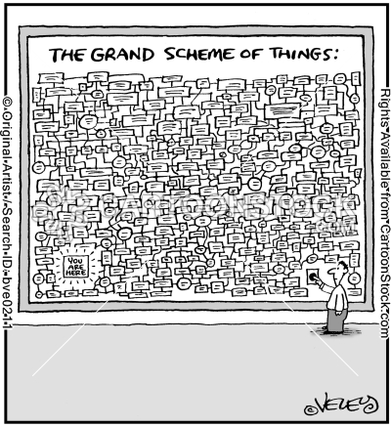

Slide 3
Alphabet of Terms
QPP (Quality Payment Program)
MIPS (Merit-based Incentive Payment System)
Advanced APMs (Alternative Payment Models)
MU (Meaningful Use)
PQRS (Physician Quality Reporting System)
VBM (Value Based Modifier)

Slide 4
Who Participates in 2018?
Physicians
Physician Assistants
Nurse Practitioners
Certified RN Anesthetists
Clinical Nurse Specialists

Slide 5
Additional Participants in 2019
Physical Therapists
Occupational Therapists
Clinical Social Workers
Clinical Pathologists
Dietitians
Nutritionists

Slide 6
Details….
Eligible clinicians billing Medicare Part B have until March 30, 2018 to submit new quality reporting structures within MACRA’s Merit-based Incentive Payment System (MIPS) for the 2017 performance year
MIPS consists of four combined scoring categories which most notably includes historical PQRS and Meaningful Use submissions recast as Quality and Advancing Care Information categories

Slide 7
Scoring….
MIPS scoring for 2018 consists of:
50% Quality Measures (Threshold increased to 60%)
(6 measures plus 1 outcome)
15% Clinical Practice Improvement Activities
(2 High- Weighted or 4 Medium Weighted Activities)
25% Advancing Care Information
(Base Score + Performance Score + Bonus Points)
Cost- 10% (Two Measures Scored, Third Party Vendors)
(30% weight for 2019 plus an additional measure )
“Last minute” inclusion of cost factor a surprise
Impact of positive and negative payments plus bonus for MIPS estimate a 0.9% increase in payments across the specialties

Slide 8
Avoid Negative Payment Adjustments
Report 1 Quality or 1 Improvement Activity or 5 Advancing Care information (MU) measures by (March 31, 2018)
5 Required Measures if decision is to use ACI category (Formerly Meaningful Use):
  Security Risk Analysis
  e-Prescribing
  Provide Patient Access
  Send summary of care
  Request/accept summary of care
Optional Bonus measures: Immunization, Secure Messaging, Patient specific education, Electronic Case reporting etc…

Slide 9
Improvement Activities
93 Improvement Activities
271 Quality Measures available
QPP.CMS.gov
Tools for MIPS
Qualify APM participant look up tool
Webinars and training videos
FYI- All SS#’s will be removed from Medicare Cards by April 2018

Slide 10
Wild Cards…
OIG report critical of CMS readiness to administer MACRA: “without sufficient technical assistance from the CMS, clinicians may struggle to succeed under the Quality Payment Program or choose not to participate."
MedPAC: “almost all of the members of MedPAC said MIPS, the new Medicare payment system for most physicians, should be replaced after MedPAC staff proposed the development of an alternative payment system to replace MIPs.”

Slide 11
